Slide 1
HP Kirchenchor pollham
© Lukas Knoll

Slide 2
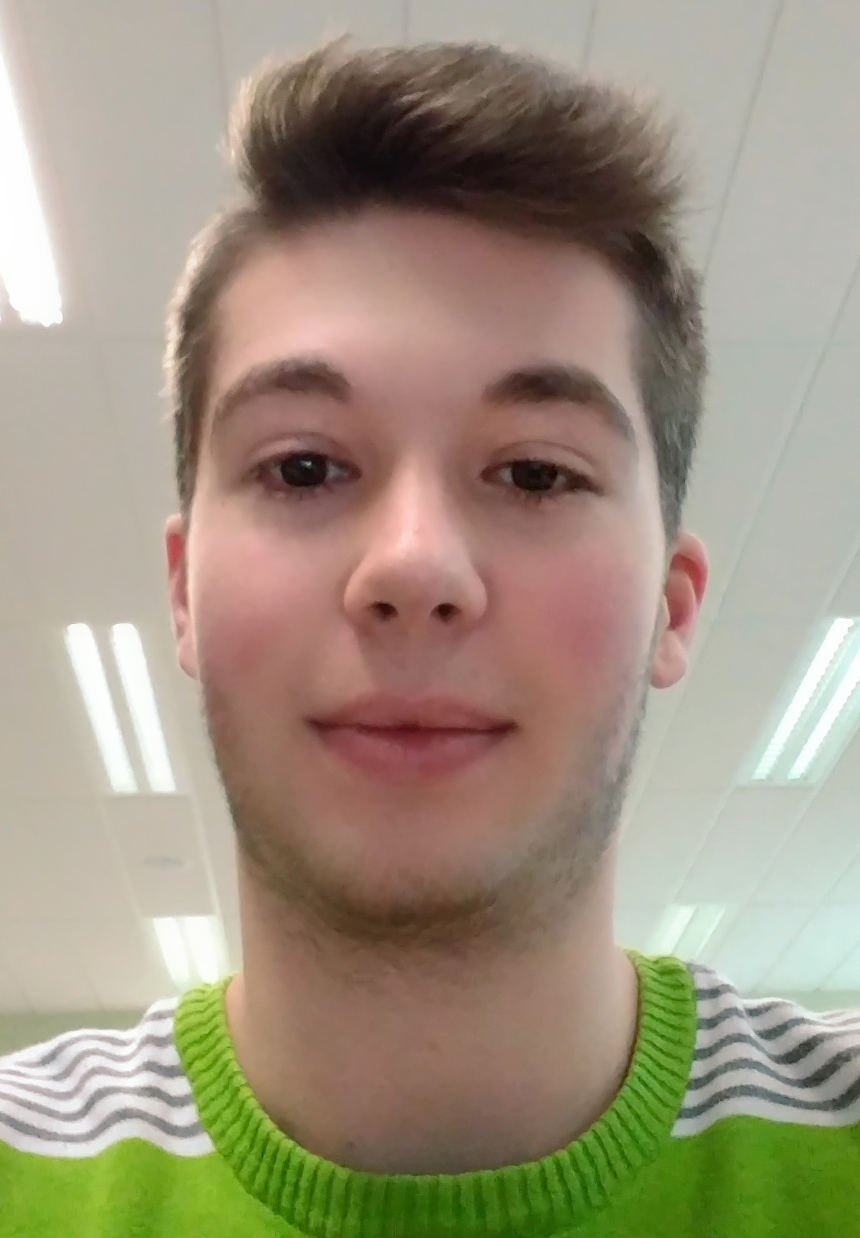
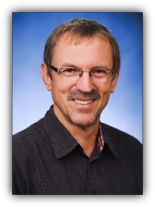
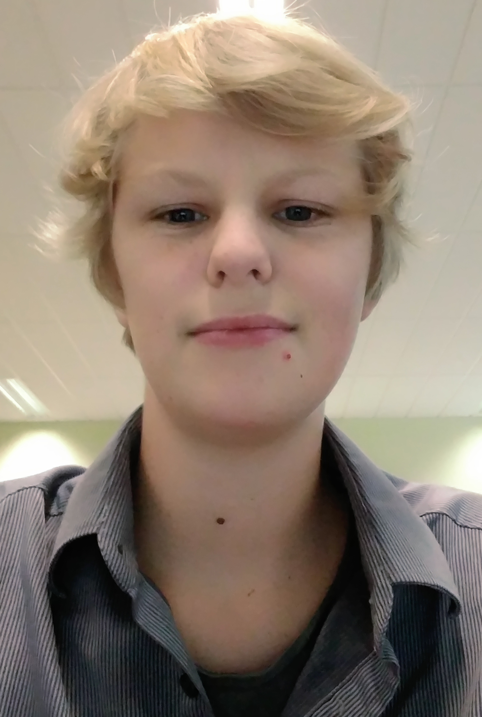
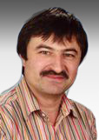
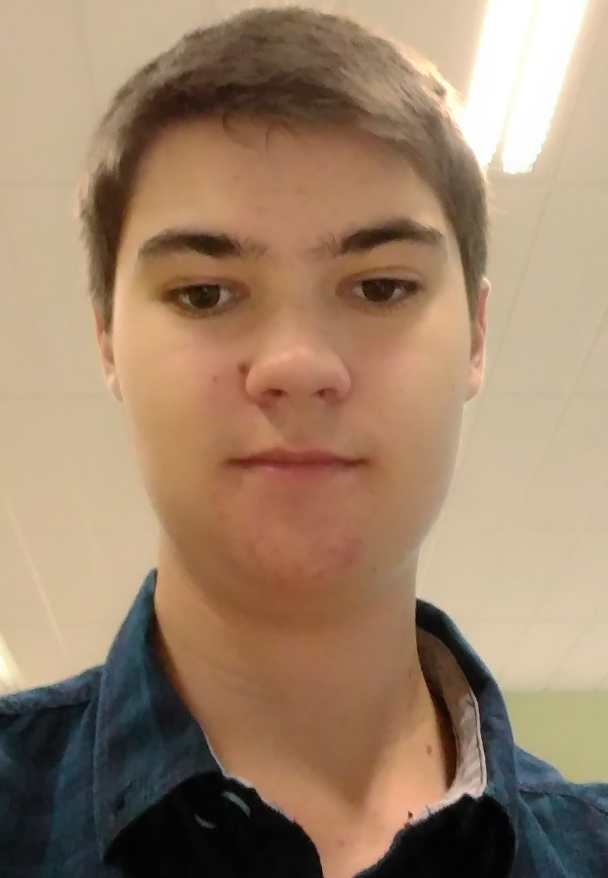
Customer And Team:
Lukas Knoll (Project Manager)
Mag. Wolfgang Froschauer
(Customer)
Niklas Graf (Team Member)
DI Josef Doppelbauer
(Intermediary) Sebastian Mandl (Team Member)

Slide 3
The Problem:
Nobody can inform himself about the choir and their events on the internet
Choir members do not have all music notes
Choir members do not have the music notes online
It‘s a lot of work to inform all the members about the next training-events

Slide 4
AIM:
Create a Homepage
Public Area und Private Area
Administration of events through Google Calendar
Store Data through Google Drive
Displaying of music notes and events in public and private areas

Slide 5
Solution:
Public area:
People are going on the website to inform them about the „Church Choir“ and see which events the choir has in the next weeks.
Private area:
Choir members should see their music notes and it should be possible, that they see the date of the next training-events.

Slide 6
StrategY:
Programming the homepage and menues
Making a database for saving the user data
(PostgreSQL-DB)
Using google libraries for the calendars and as memory for media files
(Google Calendar, Google Drive, Google Docs)

Slide 7
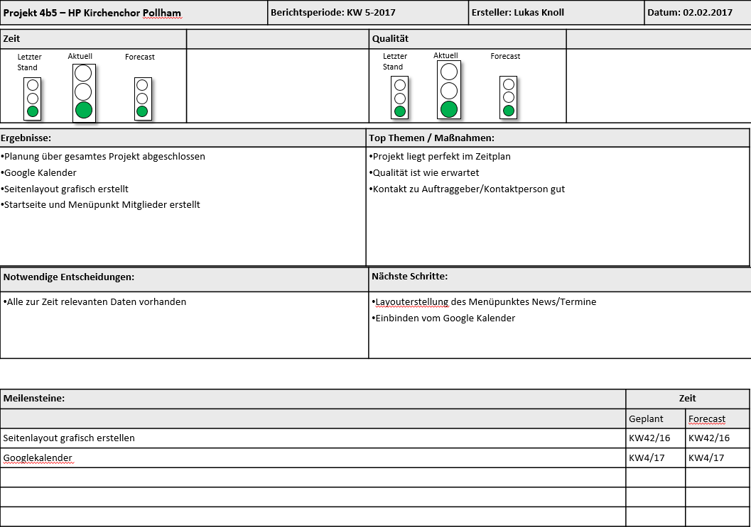

Slide 8
Basic Data and status:
Projectstart: 22.9.2016
Expected Projectend: 30.3.2016
Planned Workinghours: 254
Done Workinghours: 127
Projectclose through installation of the Homepage on a Webserver

Slide 9
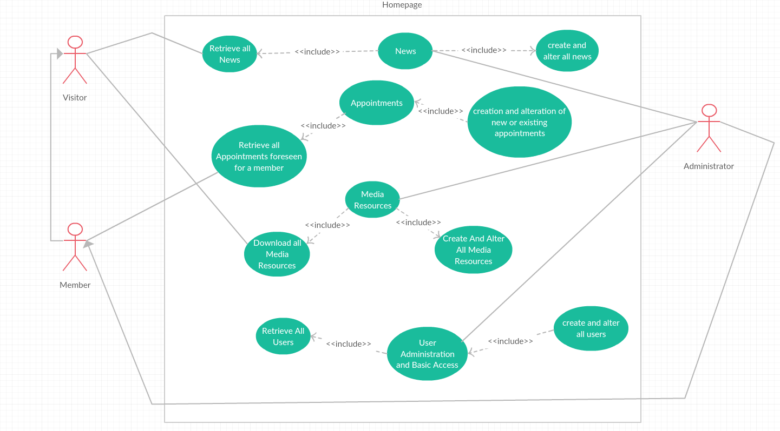

Slide 10
